Slide 1
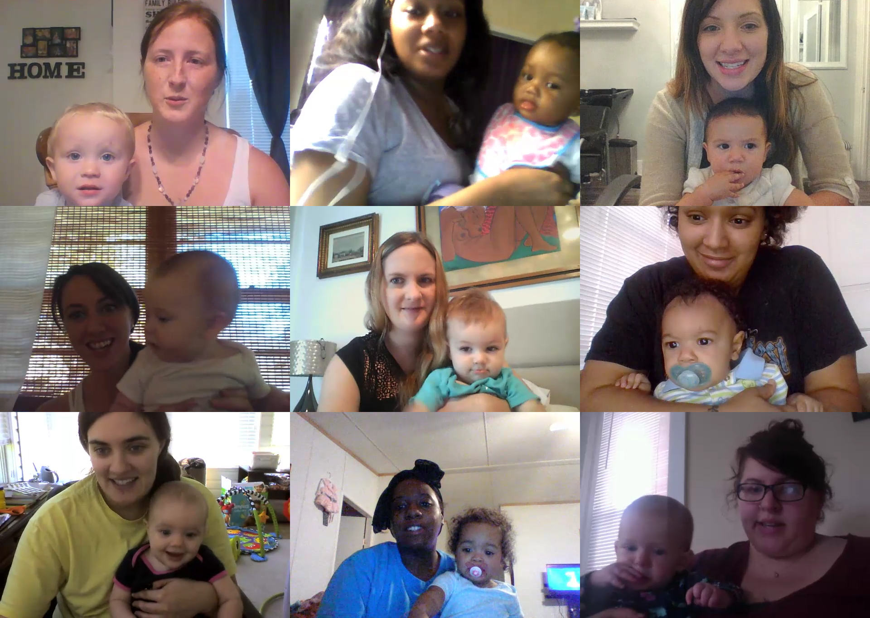

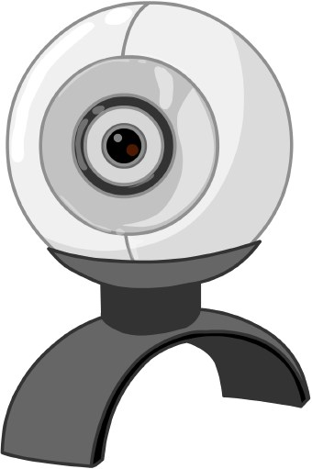
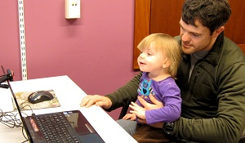
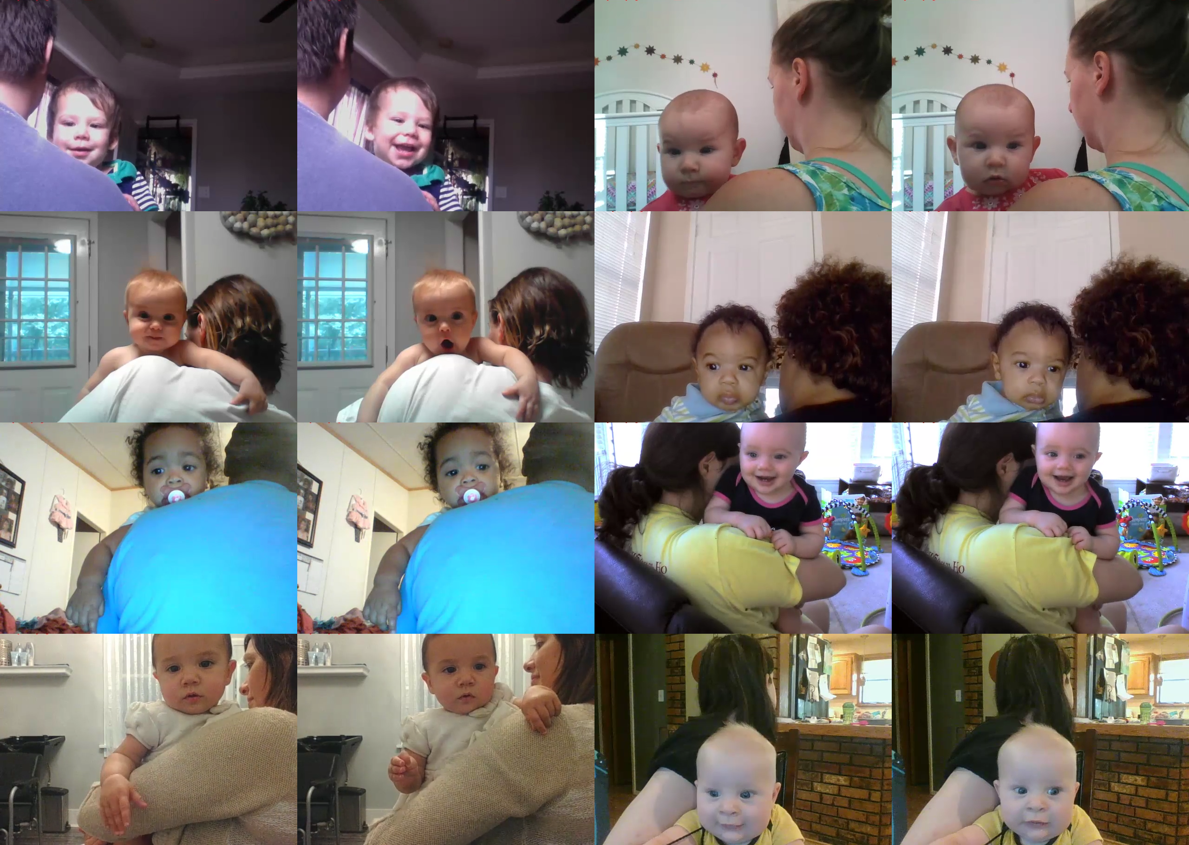
What do I need?
Understanding your child’s responses
All you need is a computer with internet connection and a webcam!
Preschool-aged children may answer questions during studies, but infants show us what they’re thinking with their eyes! We often measure how long children look at one picture or video versus another. Consistent preferences tell us that they spot differences in what they see. Below you can see some Lookit participants looking left and right.
Why bring science home?
How it works
MIT's Early Childhood Cognition Lab is trying a new approach in studying child development: bringing the experiments to you.
Most research about how kids learn and grow is currently done in labs, which limits how many kids can participate and what types of families we learn about. You can help science represent “real” families by participating any time from home on Lookit.
Right now, we’re just getting started – you’ll be a pioneer! Eventually, our hope is that online research will expand the sorts of questions science can answer about kids – including the ones parents and teachers care most about.
Create an account at https://lookit.mit.edu to get started. Register a child and you can participate right away – no need to schedule an appointment!
You and your child will do short activities in the web browser, and webcam videos of your child’s responses will be sent back to the Lookit lab for analysis.
Privacy
Just like in the lab, your data is handled with care! You’ll be asked to provide verbal consent to participate at the start of the study, and at the end you can choose what uses of your video are okay and how it may be shared, if at all.

Slide 2
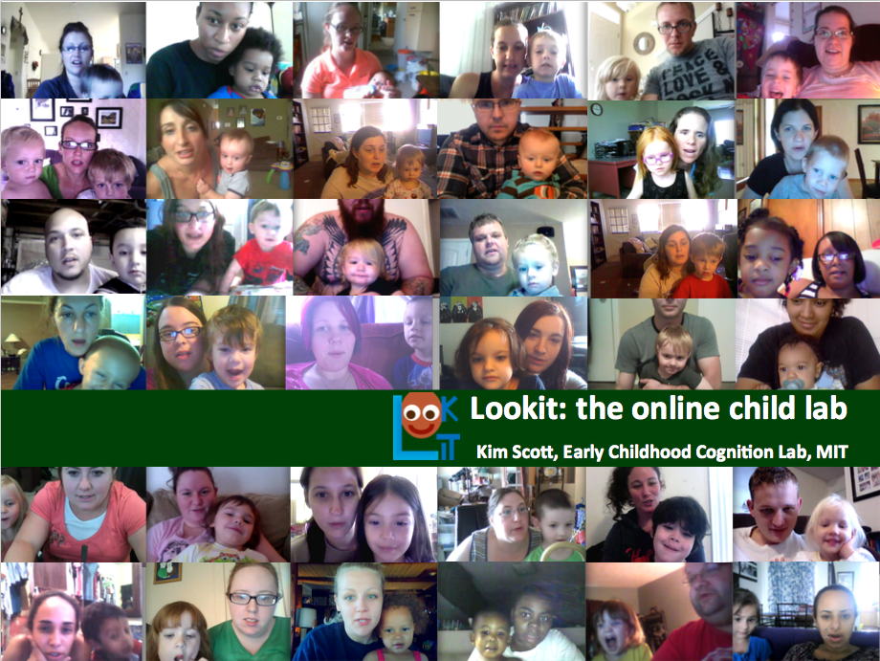
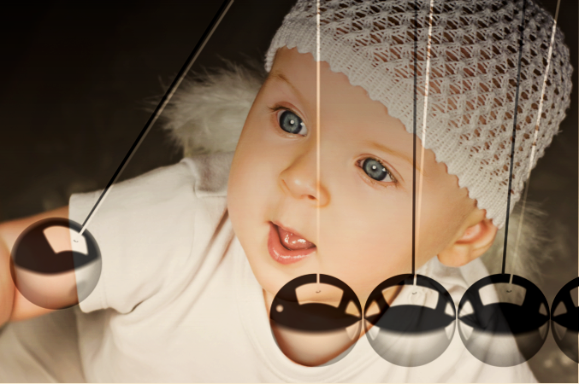
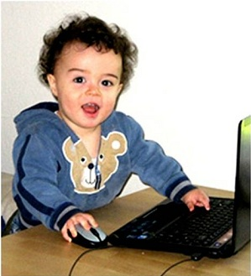

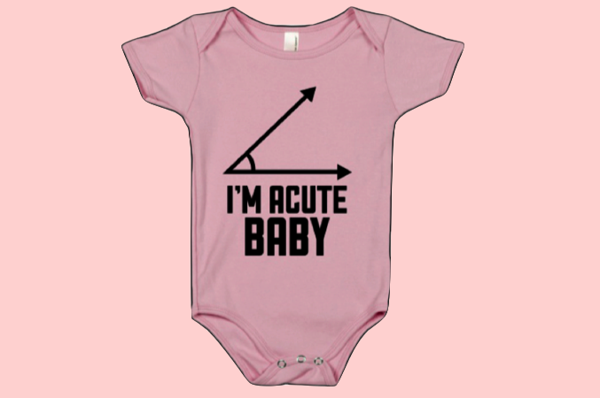




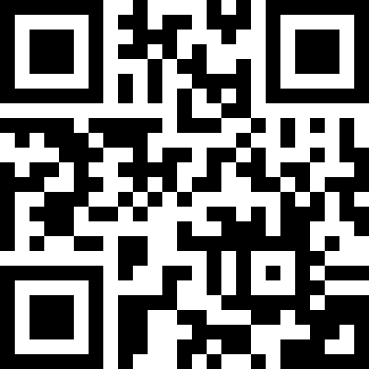

Current Lookit studies
Your baby, the physicist
Age range: 4-12 months
One+ 15-minute sessions
Questions?
In this study, we’re looking at babies’ understanding of physics principles like gravity, inertia, and support – all the things they’re learning about as they fling food off the high chair. Again.
Lookit!
Lookit!
Baby Euclid
Age range: 6.5-7.5 months
One 10-minute session
Your 7-month-old probably isn’t ready for geometry class – but he or she is already learning about shapes. In this study, your child will see side-by-side displays of magically changing triangles. We’re interested in whether children can detect changes in shape.
We’re happy to answer your questions about participating on Lookit!
Email: lookit@mit.edu
Phone: 617-324-4859
lookit.mit.edu
lookit.mit.edu
Flurps and Zazzes
Age range: 3-7 years
One 15-minute session
In this study, your child will hear stories about two groups of kids, Flurps and Zazzes, and guess how the kids will behave towards members of each group. We are interested in learning about how young children expect social groups to affect behavior.
Bring science home
Help us understand how your child thinks
Participate whenever and wherever
Reading through the Ages (coming soon!)
Age range: birth-7 years
In this study, parents simply record themselves reading with their baby or young child. We’re looking to build a body of data that can address questions like: how do parents adapt their reading behavior to their child’s level of understanding? Which aspects of reading are most important to help kids learn?

